Slide 1
Machine Learning INET
Fall 2024

Slide 2
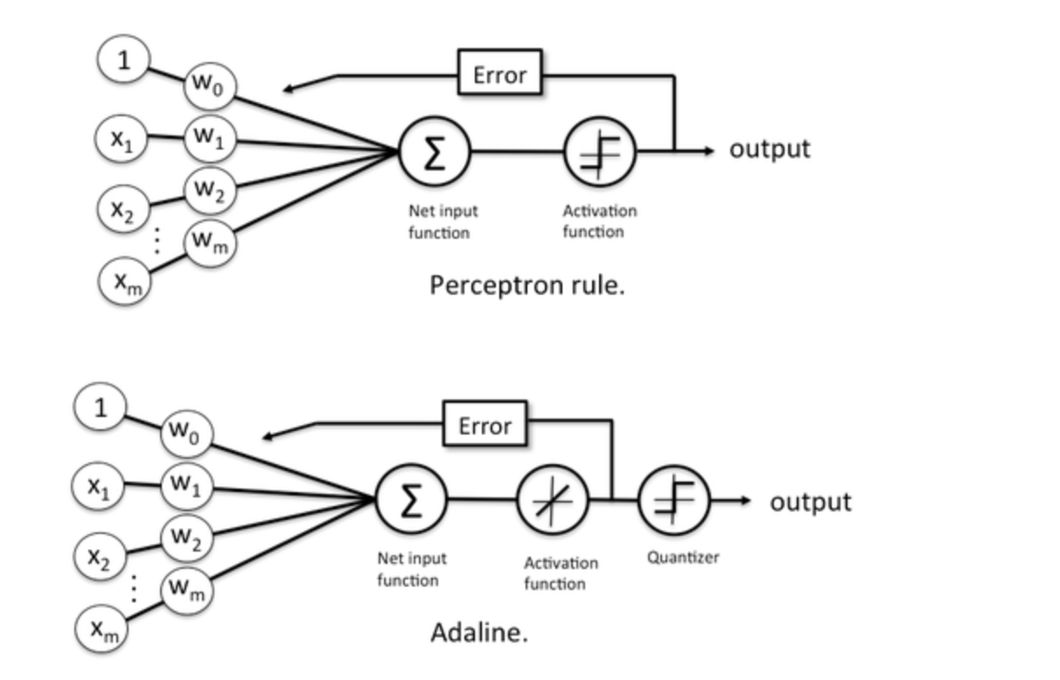
Perceptron and Adaline

Slide 3
Perceptron and Adaline - similarities
Binary classifiers
Linear classifiers
Online algorithms
Iterative algorithms
Mistake-driven algorithms
Both use a threshold function (=sign function)

Slide 4
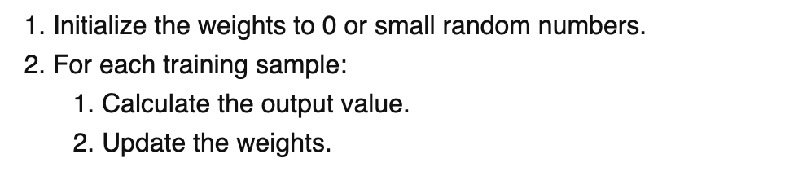
Perceptron and Adaline - similarities
Overall algorithms:

Slide 5
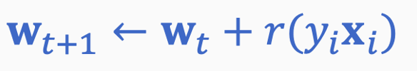
Perceptron and Adaline - difference
How they update the weights
Perceptron:
Adaline: gradient descent

Slide 6
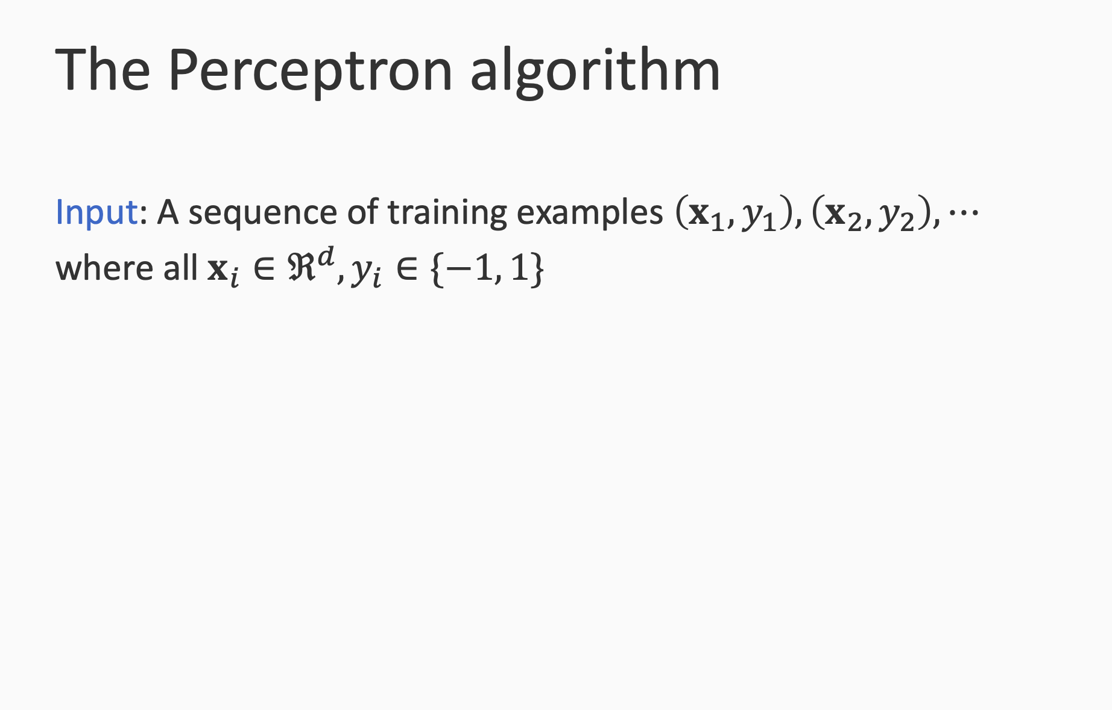

Slide 7
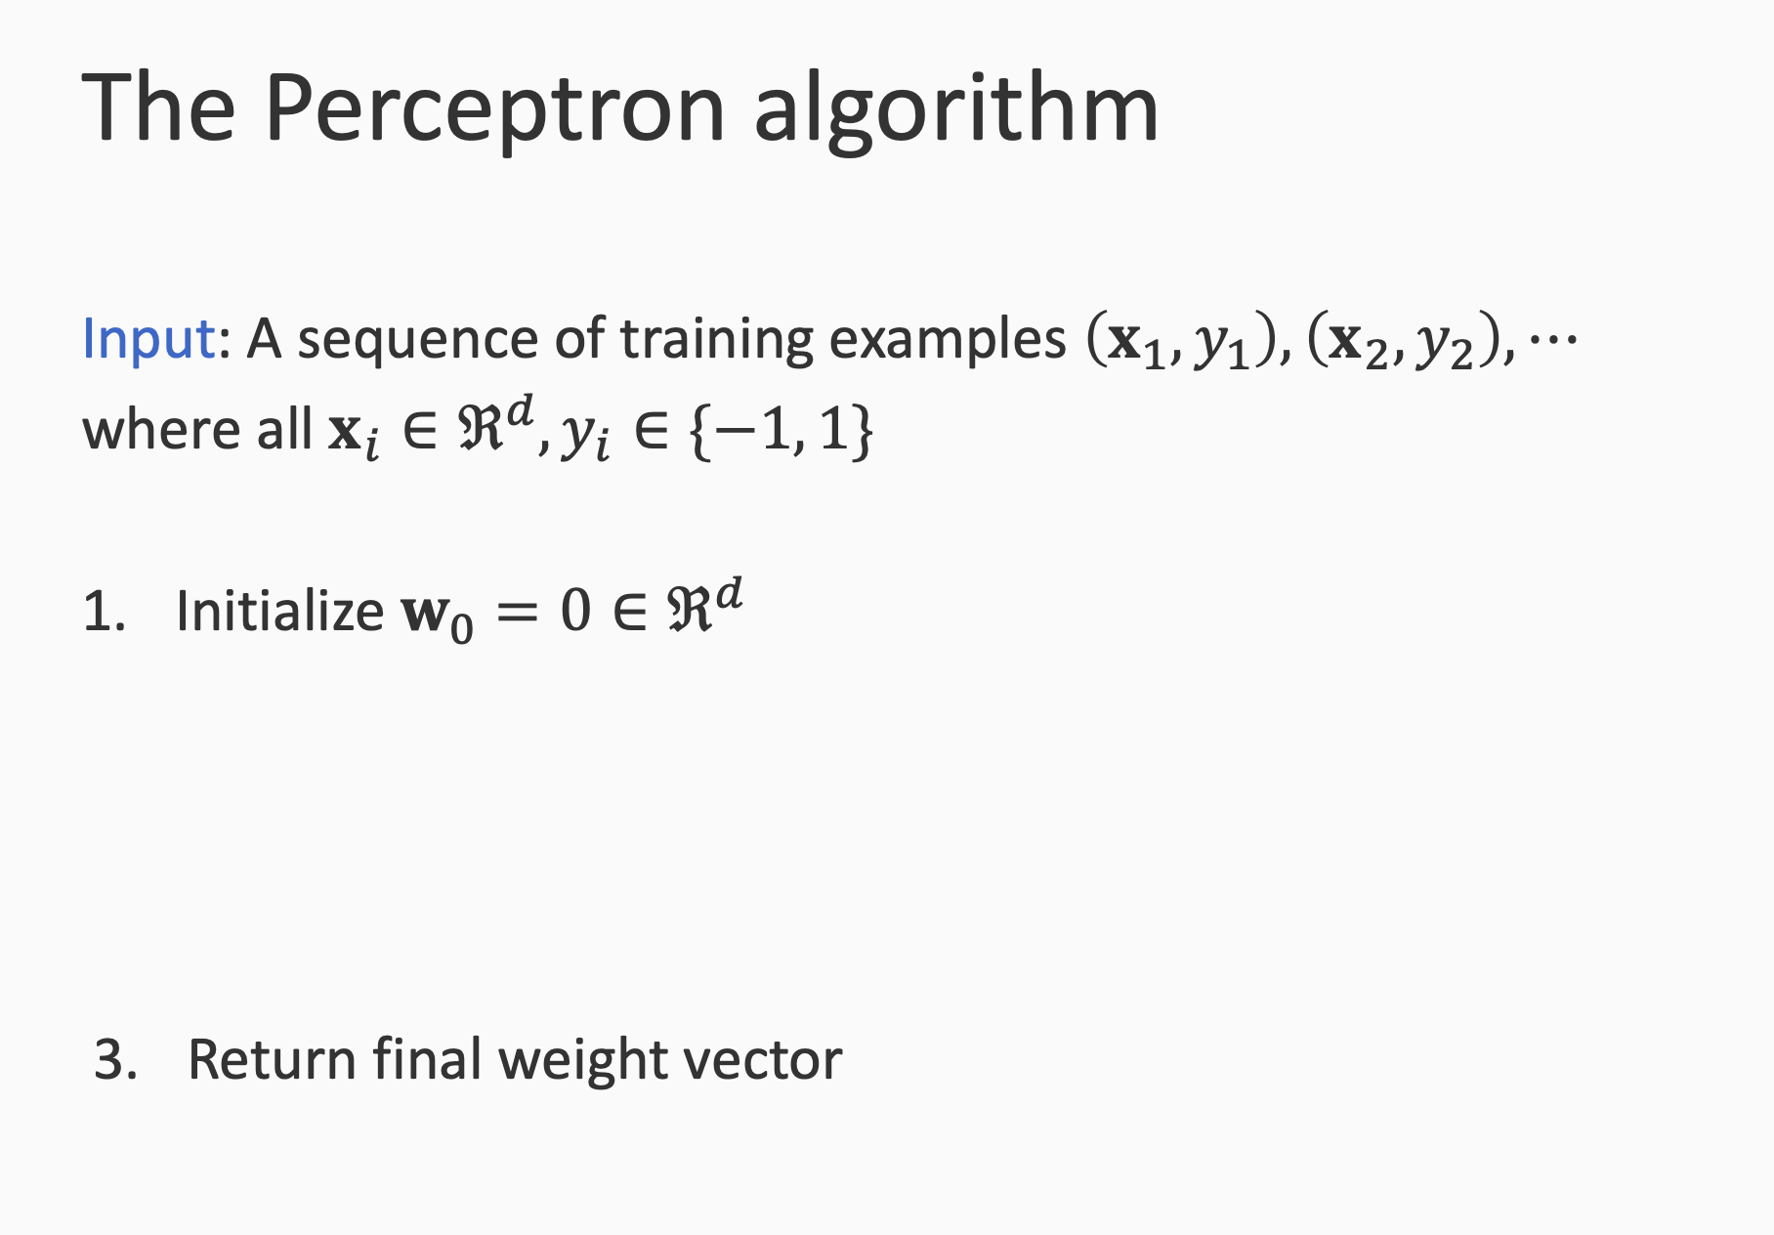

Slide 8
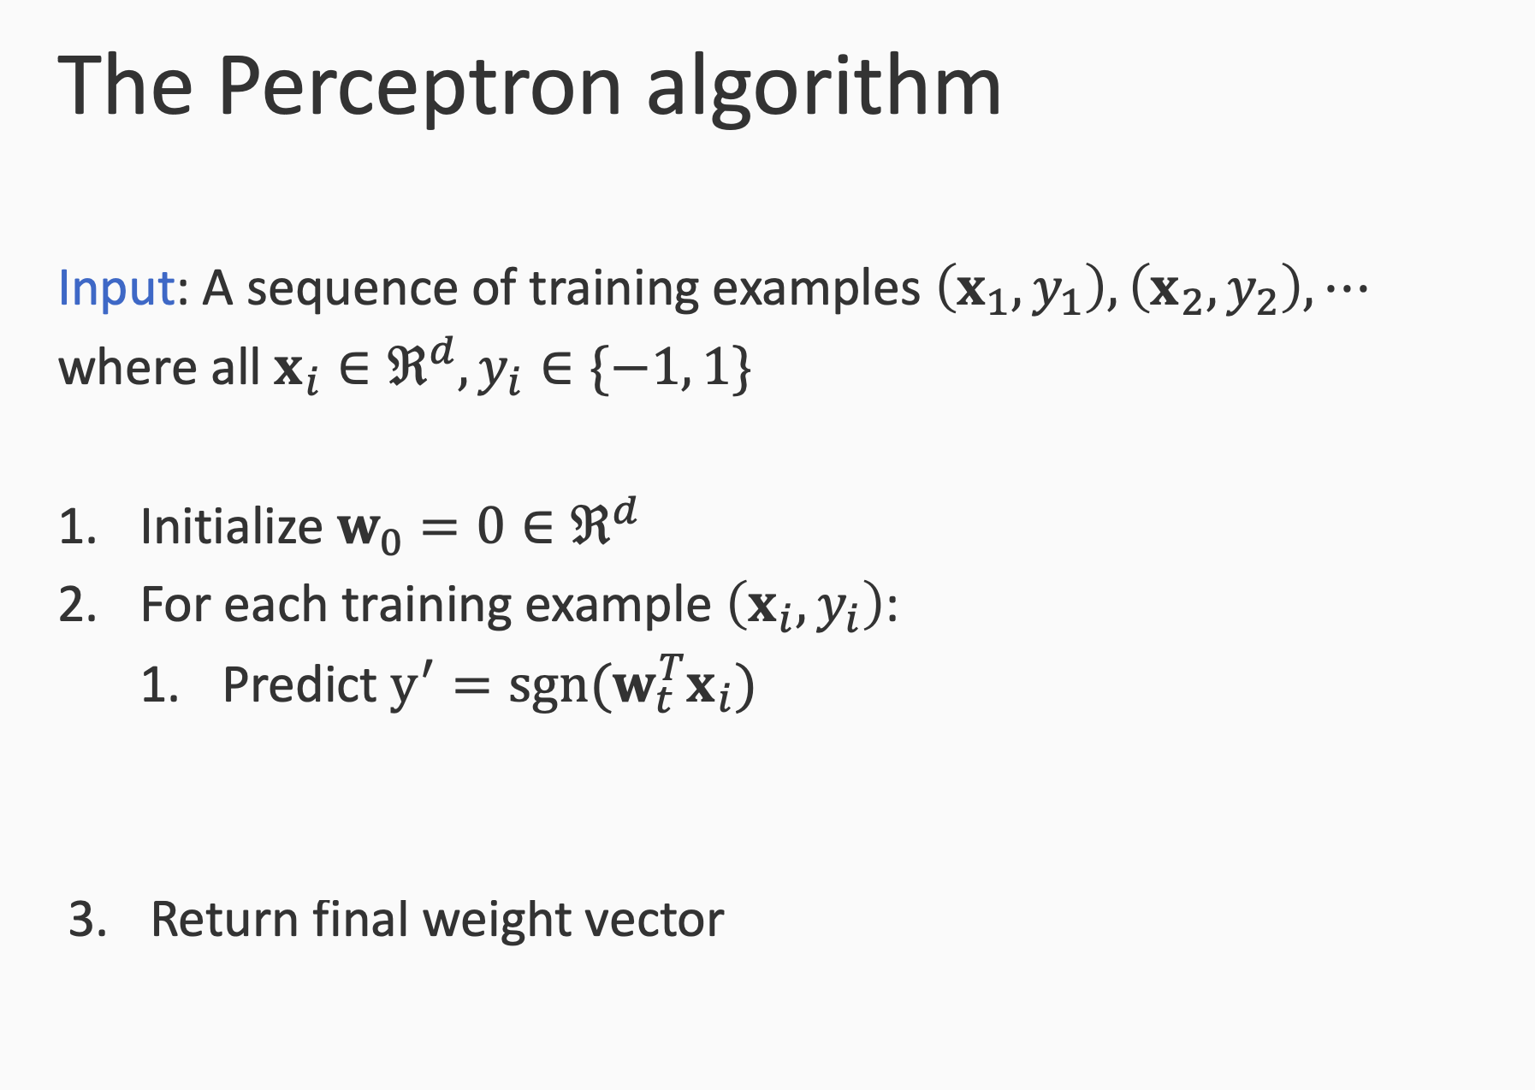

Slide 9
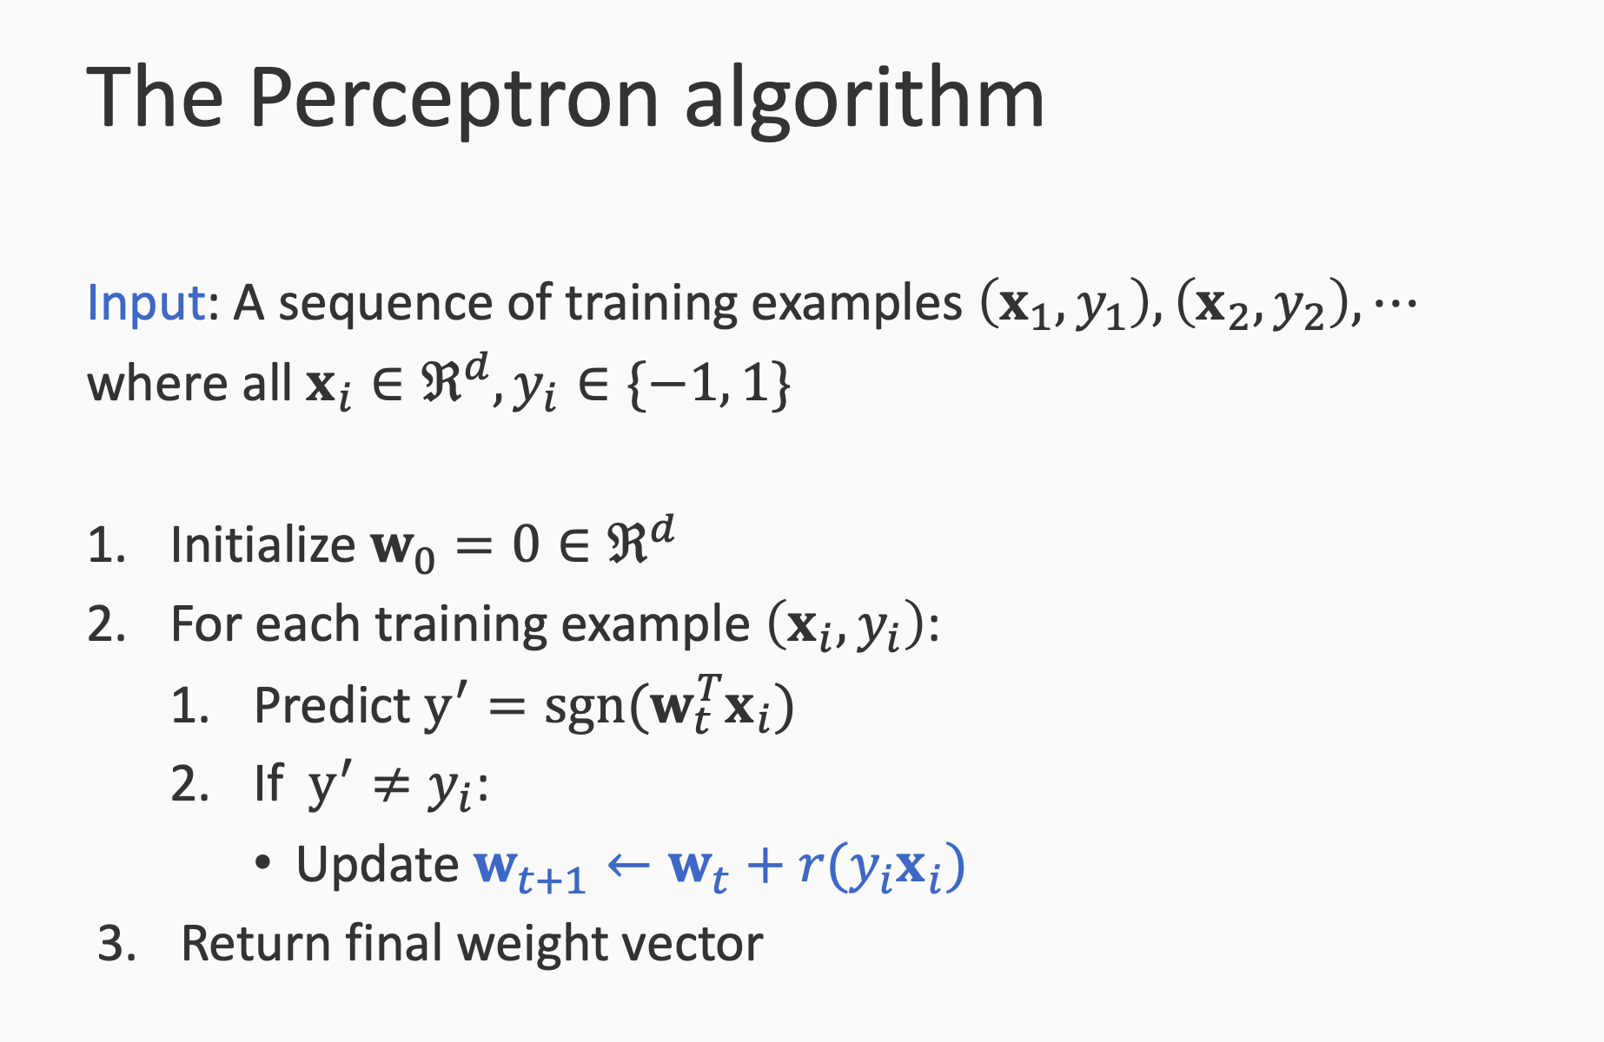

Slide 10
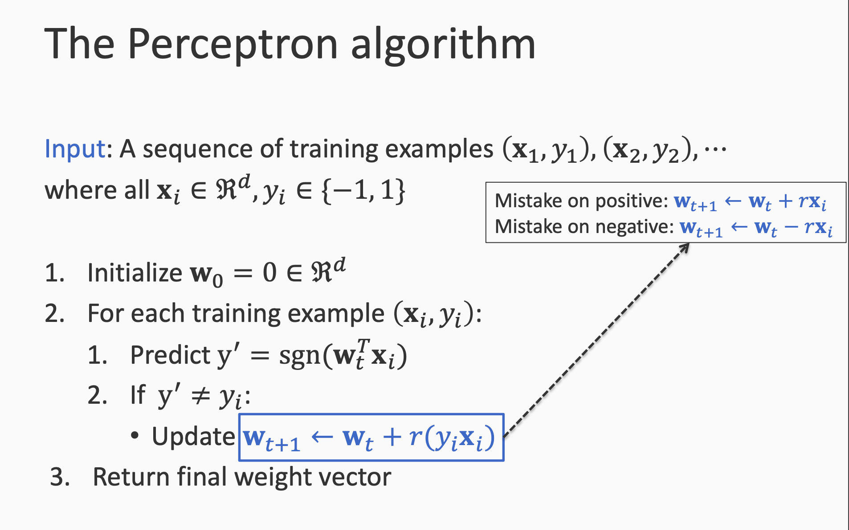

Slide 11
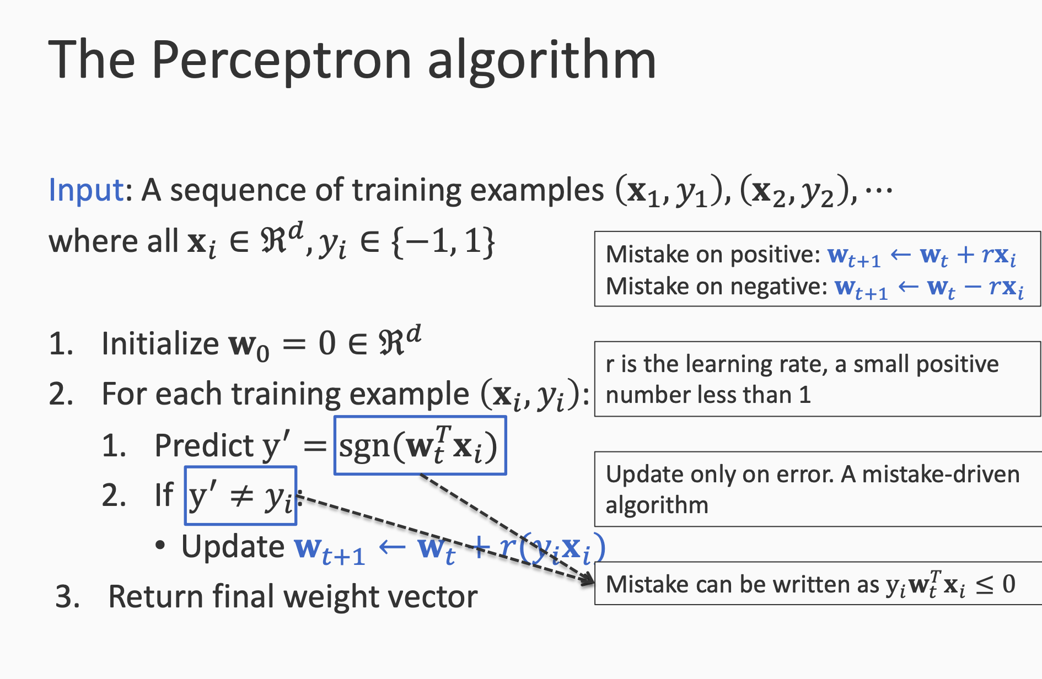

Slide 12
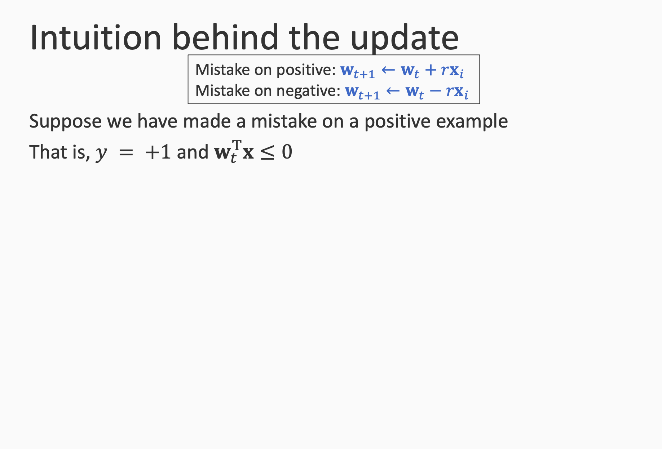

Slide 13
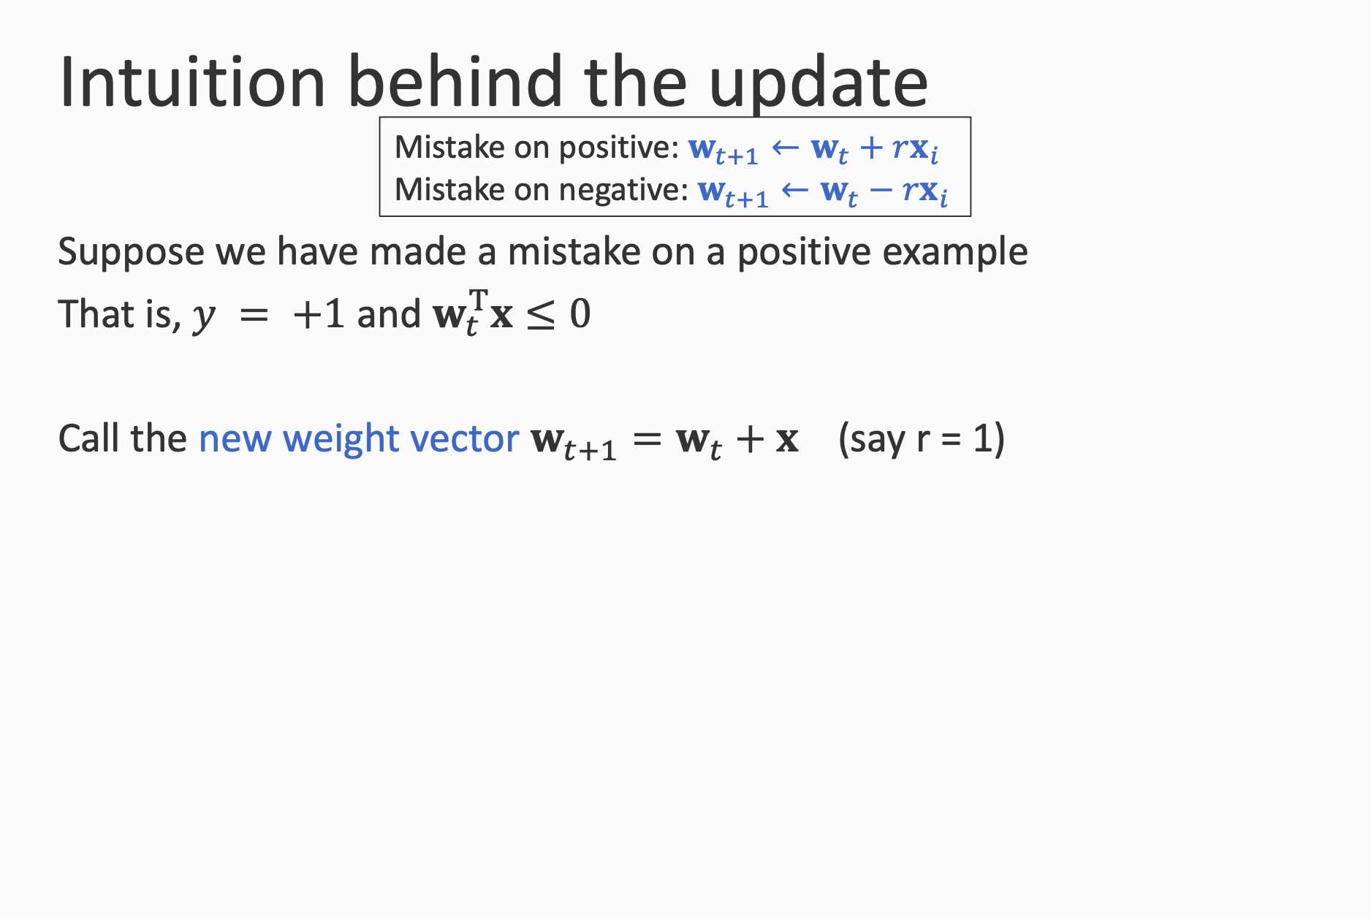

Slide 14
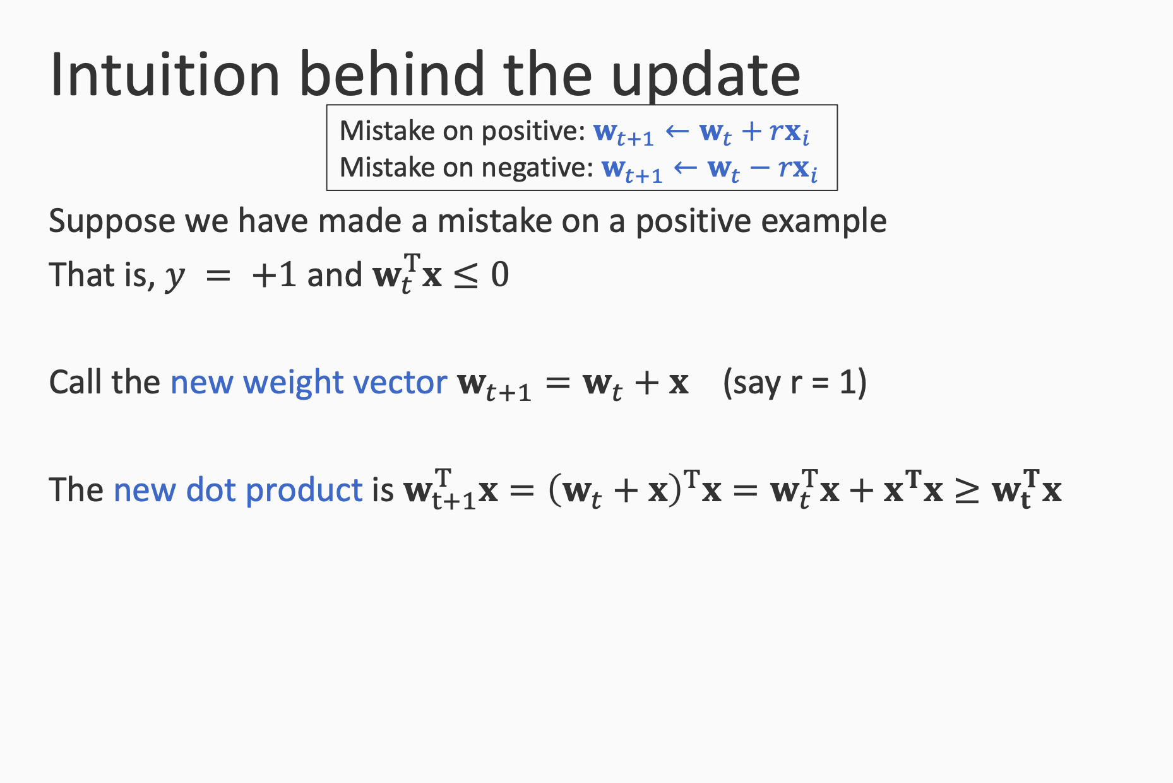

Slide 15
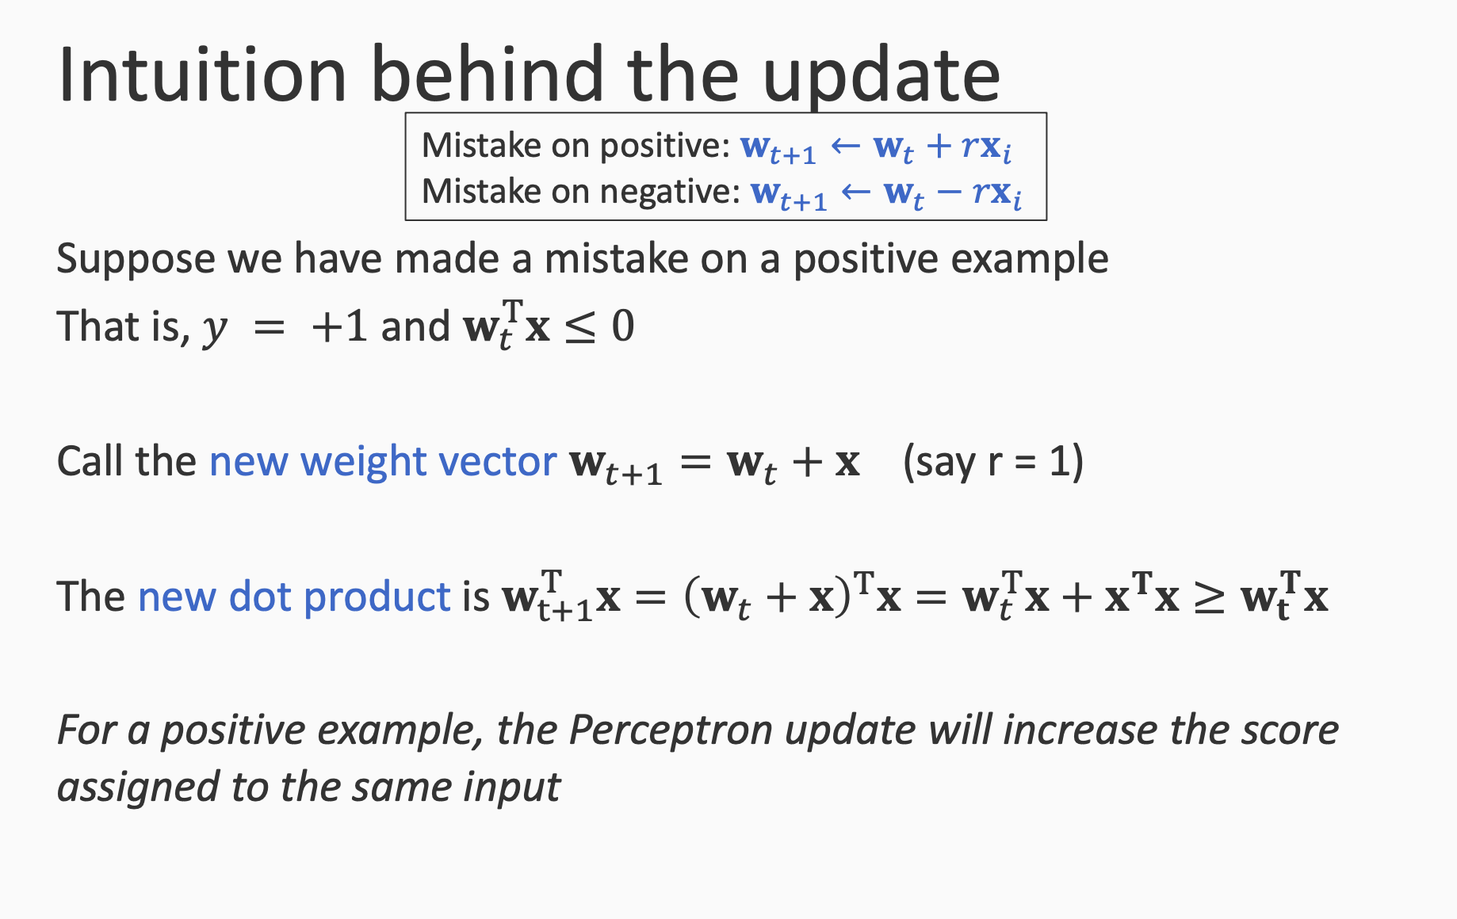

Slide 16
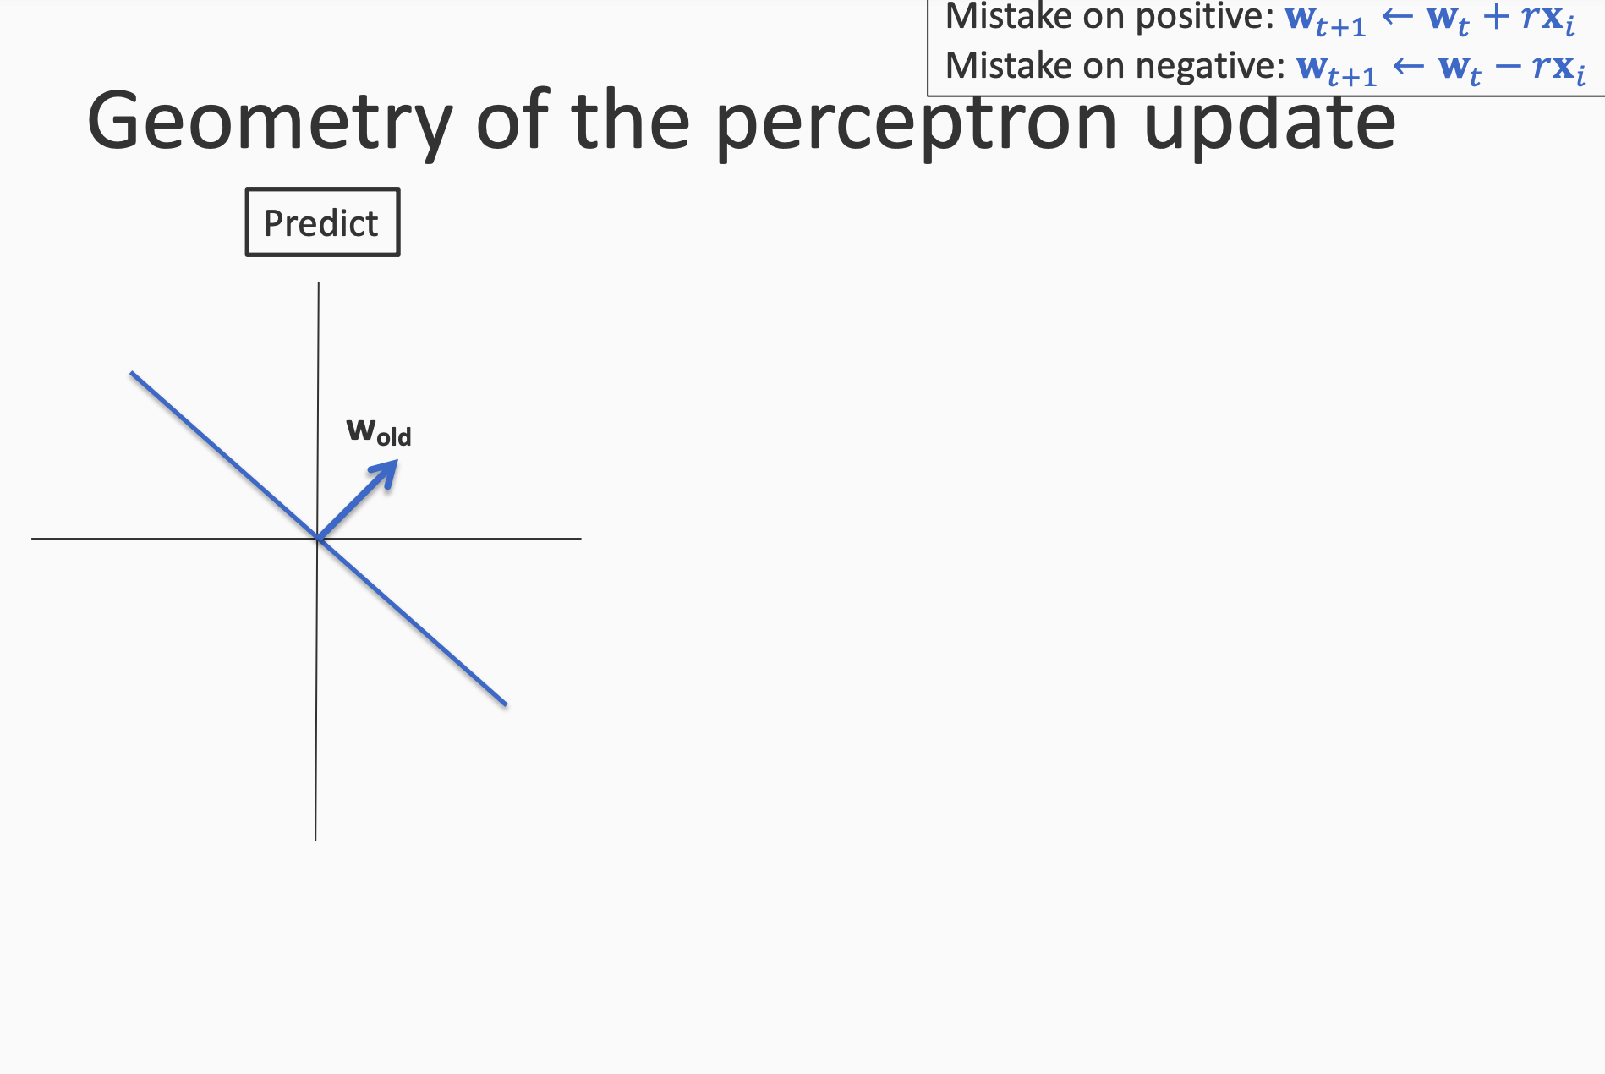

Slide 17
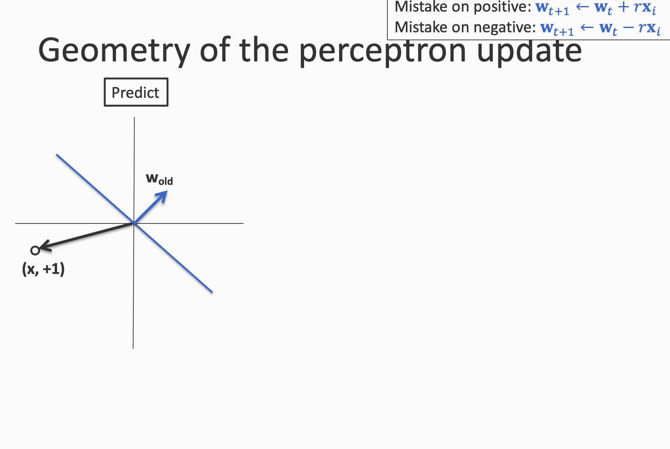

Slide 18
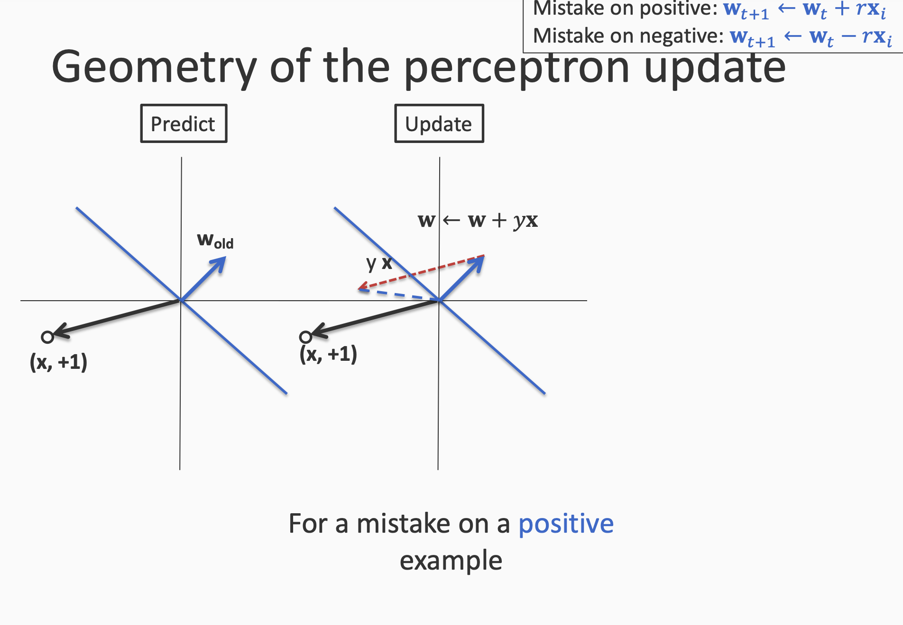

Slide 19
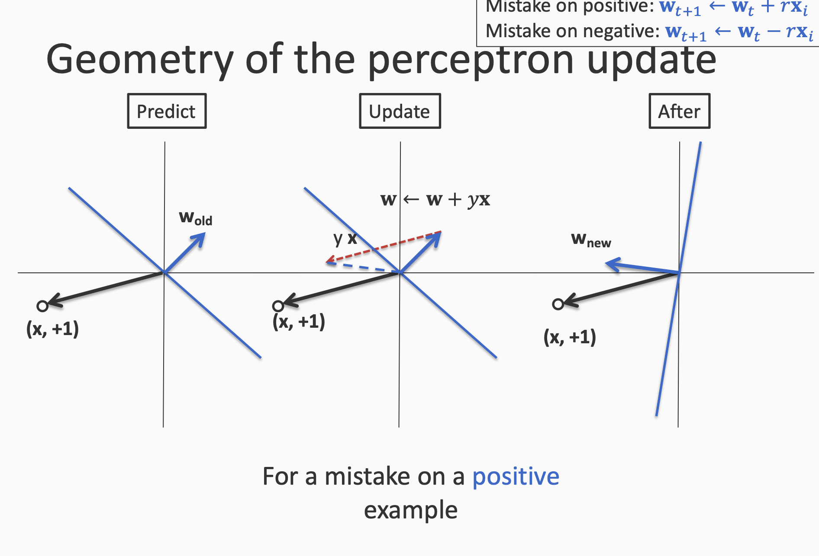

Slide 20
Variants of Perceptron

Slide 21
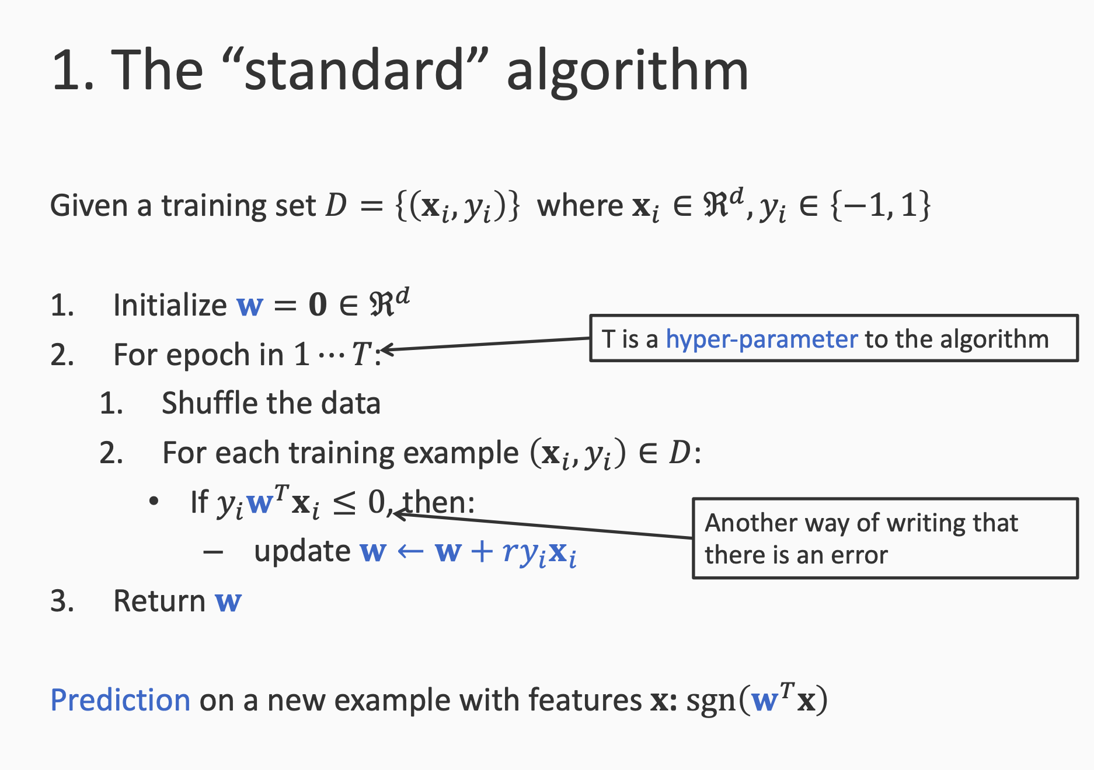

Slide 22
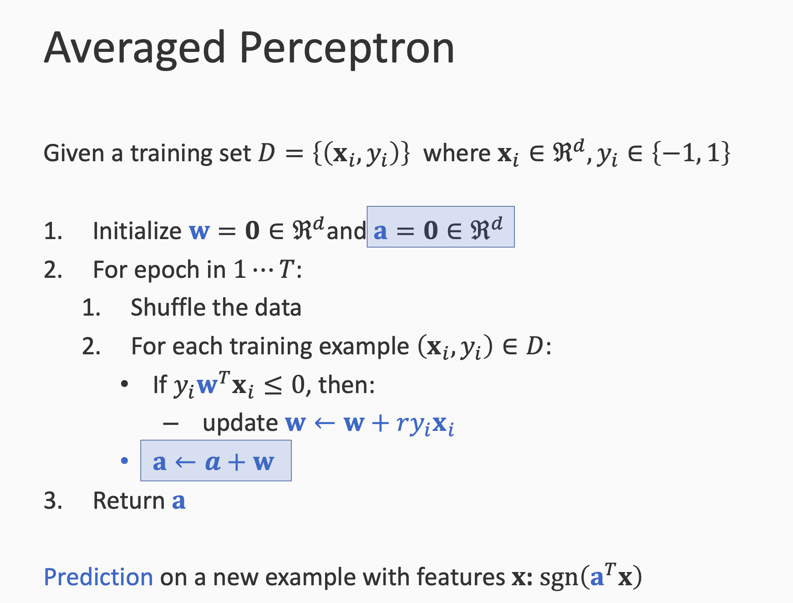

Slide 23
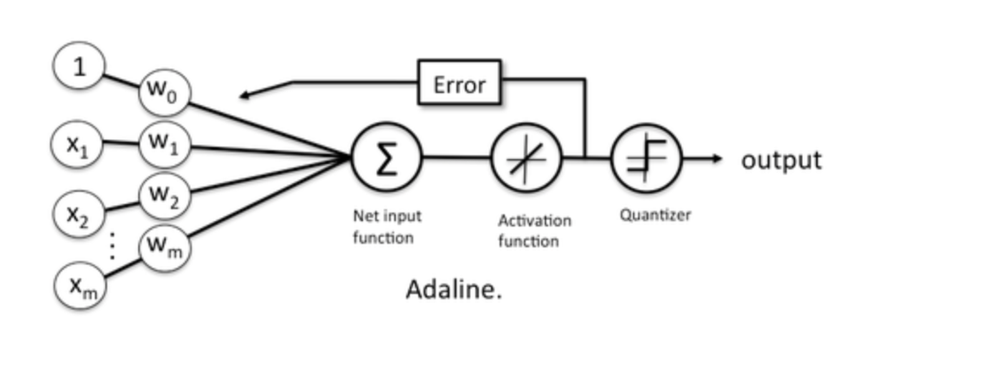
Adaline = Adaptive Linear Neuron
Adaline is a single layer neural network with multiple nodes
A multilayer network of ADALINE units is a MADALINE.

Slide 24
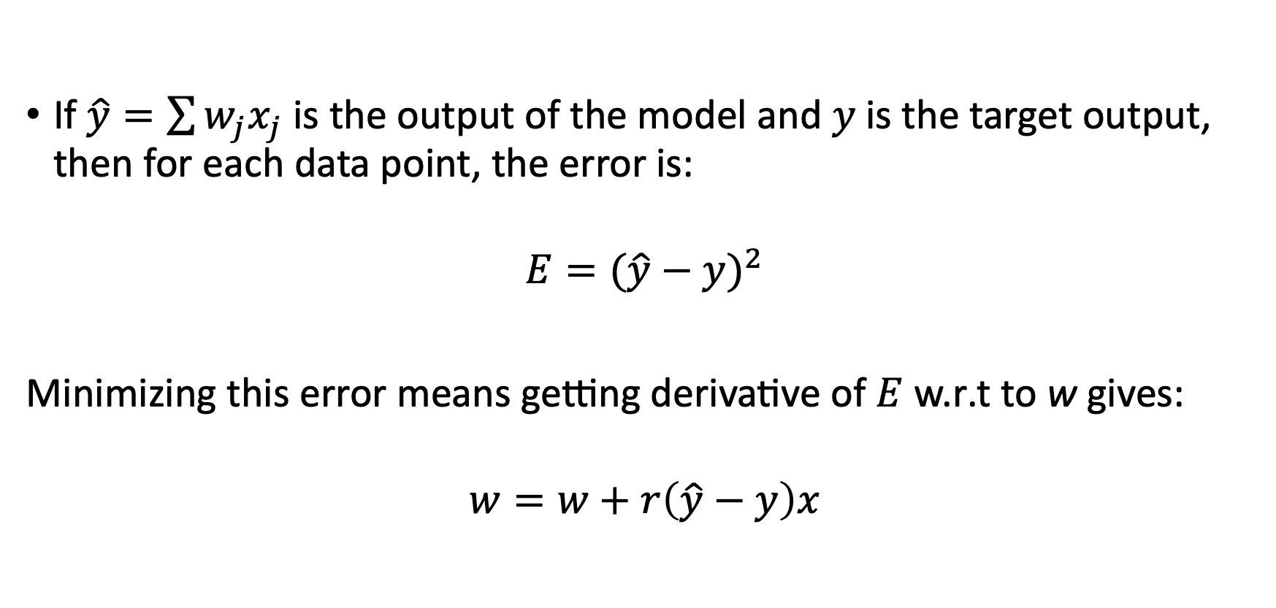
Adaline – learning rule
If $\hat{y}=\sum{w_{j}x_{j}}$ is the output of the model and $y$is the target output, then for each data point, the error is:
$$E{=(\hat{y}−y)}^{2}$$
Minimizing this error means getting derivative of $E$ w.r.t to w gives:
$$w=w+r\left(\hat{y}−y\right)x$$

Slide 25
Reference for slides
https://svivek.com/teaching/lectures/slides/perceptron/perceptron.pdf

